Slide 1
Project Delivery #2 Machine Learning based Text Classification
Group Members:
1- 150118065 Şeref Kutay Akgün
2- 150119572 Burak Furkan Ayvalık
3- 150118501 Engin Bektaş
4- 150114058 Oğuzhan Erkol
5- 150119869 Umer Selmani
LECTURER : Assoc. Prof MURAT CAN GANİZ

Slide 2
Lıbraries that I use
NLTK:
This library was developed for parsing text in NLP.
It allows us to perform operations such as tokenize into sentences and words, removing Stopwords, Collocations, Parts of speech identification, Stemming and lemmatization, Corpus
JSON:
This library allows us to read json files properly.
OS:
This library allows us to count number of file in the input folder. pandas:
Pandas is a fast, powerful, flexible and easy to use open source data analysis and manipulation tool, built on top of the Python programming language.

Slide 3
Models That ı Use:
Random Forest Classifier:
A random forest is a meta estimator that fits a number of decision tree classifiers on various sub-samples of the dataset and uses averaging to improve the predictive accuracy and control over-fitting.
SVM:
Supervised learning models with associated learning algorithms that analyze data for classification and regression analysis.
Multinomial Naive Bayes:
This is a Bayesian learning approach popular in Natural Language Processing (NLP). The program guesses the tag of a text, such as an email or a newspaper story, using the Bayes theorem. It calculates each tag's likelihood for a given sample and outputs the tag with the greatest chance

Slide 4
How the project works:
First, by running preprocess.py, the "crime" and "ijtihad" parts in the json files are extracted. I make the data workable by applying operations such as clearing stopwords, editing characters, removing punctuation marks on the extracted parts. Then I save this data in a new csv file. In order not to deal with rare labels separately while making classification, I collect the labels other than the 30 most common labels under the "other" heading and save the modified data in the "modified.csv" file.

Slide 5
How the project Works(Cont.):
Then I run the main.py file. In this file, I first read the "modified.csv" file using the pandas library. After specifying the columns and rows, I show how many of each label on the screen. Then, with the chi square test, I print the most common "unigram" and "bigram" used in each label to the console. Then I parse the data into 20% tests and 80% trains.

Slide 6
How the project Works(Cont.):
I apply Random Forecast Classifier, SVM and Multinomial Naive Bayes Classification methods to the parsed data. I print the accuracy values that I obtained as a result of the classification on the screen, at the same time I show the efficiency graph on the screen. As a result of the classification test I have done, I got the highest score from SVM. Then I print the "precision", "recall", "f1-score" values belonging to the SVM classification to the console for each label.

Slide 7
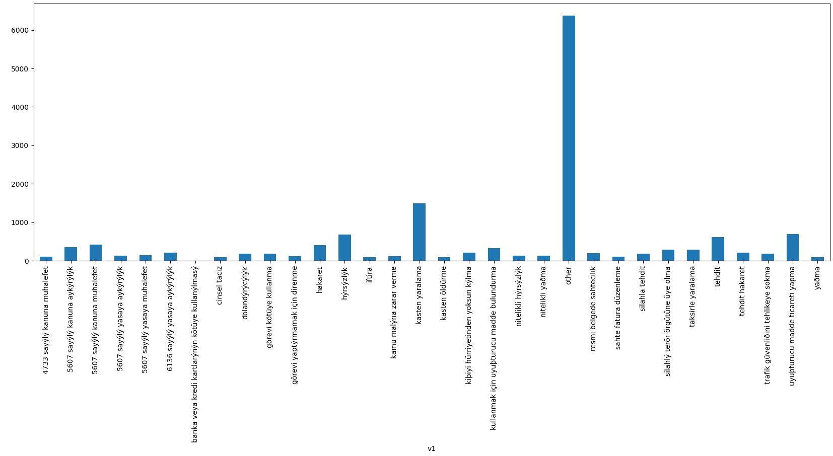
Some of the results:
label distribution

Slide 8
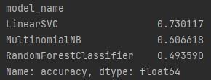
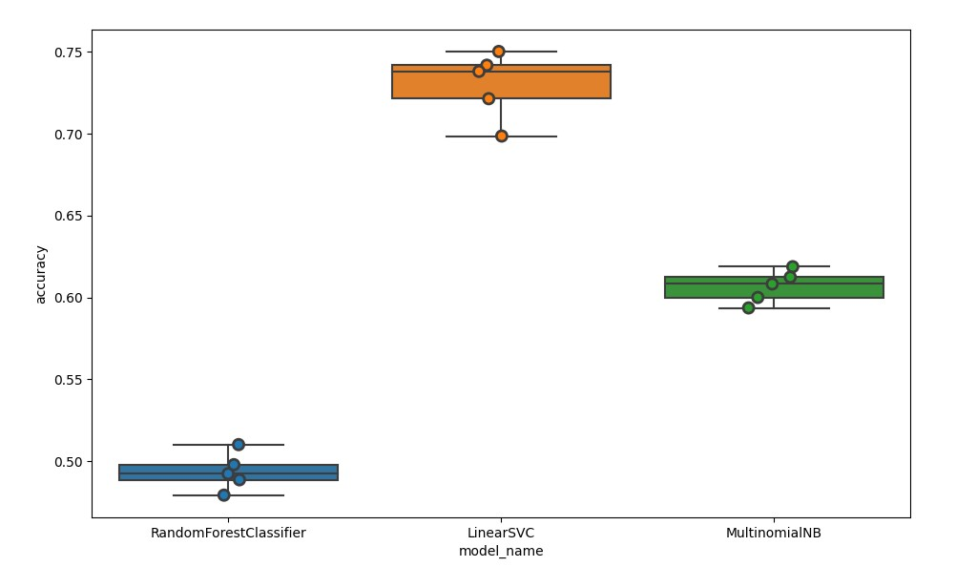
Some of the results:
Accuracy scores
Accuracy scores plot

Slide 9
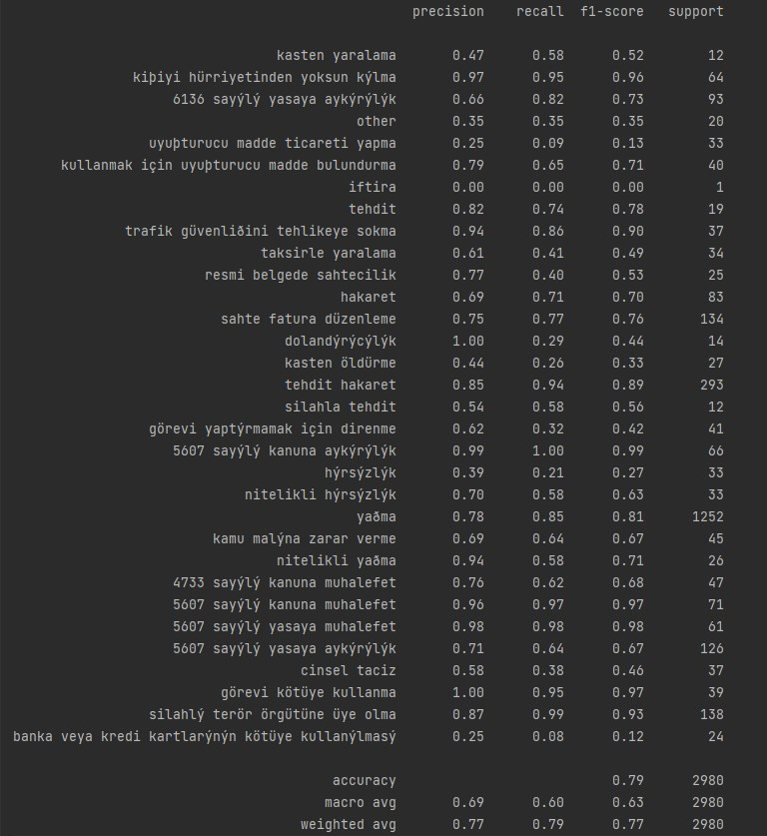
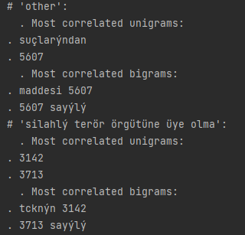
Scores for SVM
Chi square test results

Slide 10
Prepared BY: Seref Kutay Akgun
Thank You for Listening

